Slide 1
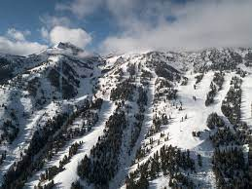
Big Mountain Ski Resort

Slide 2
Increasing revenue at Big Mountain Ski Resort
Current pricing strategy
Based on average pricing in market segment
Does not take into account how the Big Mountain Ski Resort facilities compare to the average.
Solution
Using data a comparison will be made to compare the facilities of Big Mountain Ski Resort to other resorts in the market.
A comparison will be made to see what other resorts with similar facilities charge
Also use data to analyze where cuts to costs can be made.

Slide 3
Results and Suggestions
Big Mountain Ski Resort is in the top echelon of ski resorts based on facilities.
Current pricing strategy below market with resorts of similar facilities.
Data suggest a new price of 89.81 – 99.88 (10.8% - 23.3% increase)
A dynamic pricing model that fluctuates with the demand could increase revenue without dropping overall ticket sales.
Big Mountain Ski Resort should permanently close the least used run.
Data suggests that the closure of 1 run will have no effect on revenue or ticket prices.
Increasing vertical drop by 150 ft., adding a run and installing an additional chair lift could increase ticket price by 1.94
Since data supports cutting a run without any effect to revenue and ticket prices. Only adding the vertical drop and the chair lift might give the same results.

Slide 4
Modeling and Analysis
Data provided by database manager has key metrics for 330 ski resorts in the United States.
Linear regression model was developed to determine what facilities demanded higher fees.
Following graphs show the ticket prices for resorts that have a given type of feature.

Slide 5
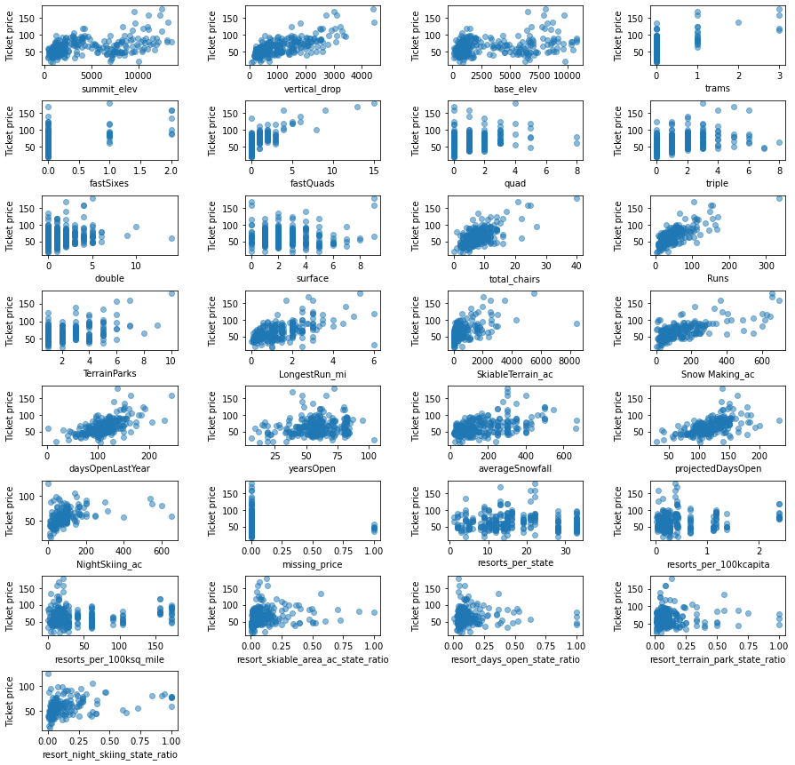

Slide 6
Analysis
From the previous graphs a list of features where determined to be the most important to a paying customer.
Fast Quads
Vertical Drop
Snow Making abilities
Night Skiing
Number of chairs
Total number of runs
The following graphs compare Big Mountain Ski Resort vs other resorts in the above features.

Slide 7
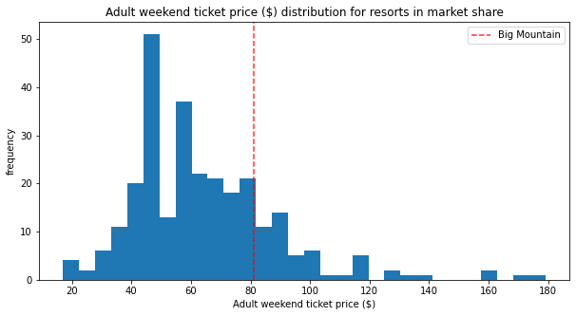
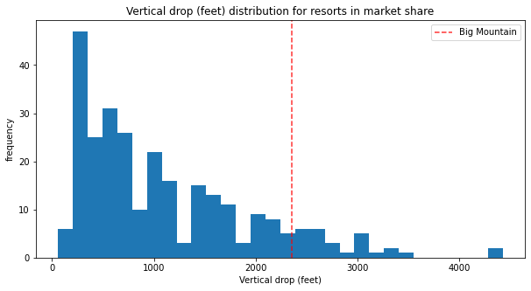
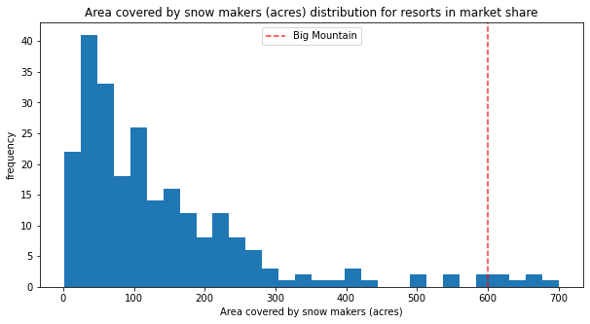
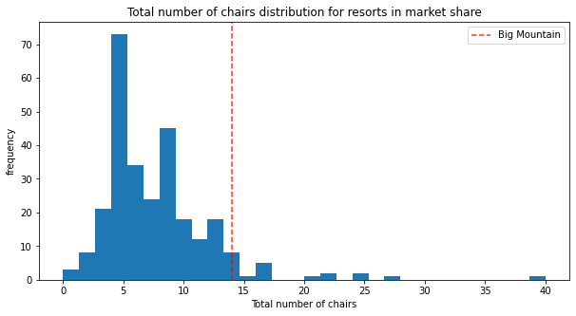
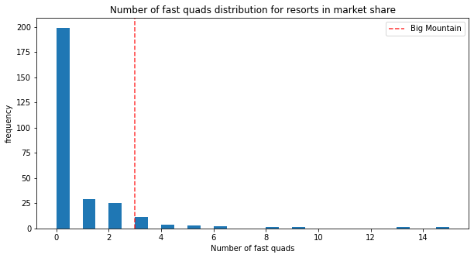
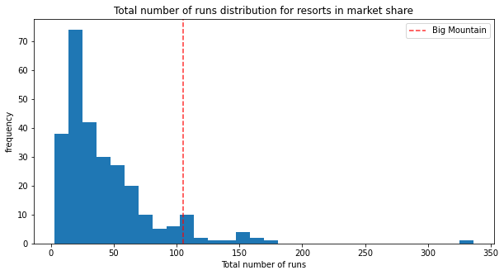

Slide 8
Conclusion
Big Mountain Ski Resort should develop a dynamic price model with a base of 89.81 and a top of 99.88
To lower costs closing of the least used run will not effect revenue nor ticket prices.
Next project should focus on increasing vertical drop as well as adding another chair lift.

